Slide 1


Session – 2
operators
Name :Lavanya Mohan
Email :lavanya@metaverseage.ae

Slide 2
Recap
Interpreter
Python Advantage
Variables
Data Types
Print Poem

Slide 3


Write a Program in python to print your Favourite English Rhyme
Use Format and necessary punctuations

Slide 4


User input
Output
Enter your Name :Metaverse
Enter your Age:1
Name:Metaverse
Age:1
Coding
a=(input(“Enter your Name”))
b=int(input(“Enter your Age”))
print(“Name:”,a)
print(“Age:”,b)

Slide 5
Write a Python program that accepts the user's first and last name and prints them in reverse order with a space between them
fname = input("Input your First Name : ")
lname = input("Input your Last Name : ")
print ("Hello " + lname + " " + fname)
Output
Input your First Name : lavanya
Input your Last Name : mohan
Hello mohan lavanya

Slide 6
Comment line
# this is my single comment line
Single comment line
Multiple Comment line
”””this
is
my
multiple
Comment line
”””

Slide 7
calculates the area of a circle
from math import pi
r = float(input ("Input the radius of the circle : "))
print ("The area of the circle with radius " + str(r) + " is: " + str(pi * r**2))
Output
Input the radius of the circle : 5
The area of the circle with radius 5.0 is: 78.53981633974483

Slide 8
Introduction to Python Programming
Session 2

Slide 9

Operators
Arithmetic Operators
Assignment Operator
Comparison or Relational Operator
Logical Operator
Bitwise Operator

Slide 10
Arithmetic Operator
OPERATORS +, -, *, /, %
Addition
Subration
Multiplication
Division
modulO
A=int(input(“Enter your First Number”))
B=int(input(“Enter your second Number”))
C=A+B
Print(“Total”,C)
C=A-B
Print(“Different”,C)

Slide 11
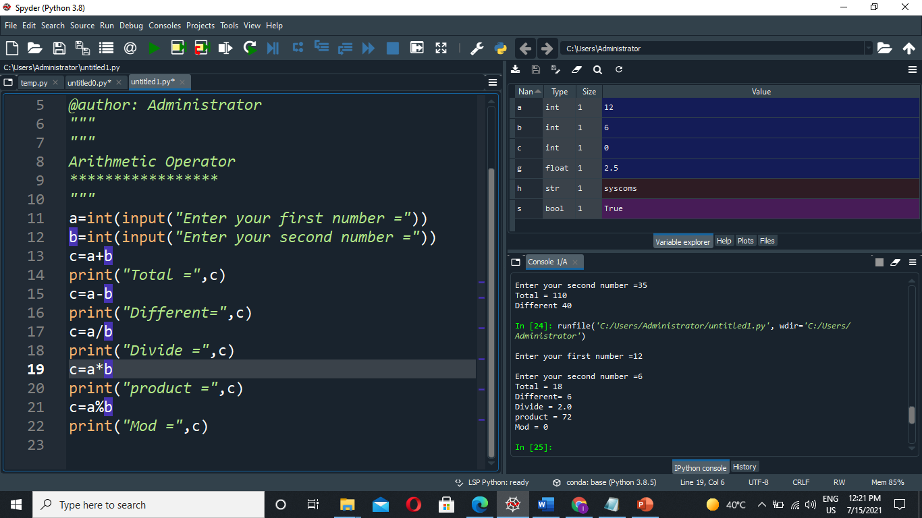
EXAMPLE

Slide 12
Assignment operator
OPERATORS +=, -= ,*= ,/= ,%=
Assignment operators are used in Python to assign values to variables. a = 5 is a simple assignment operator that assigns the value 5 on the right to the variable a on the left. There are various compound operators in Python like a += 5 that adds to the variable and later assigns the same.

Slide 13
Example Program
a=10
a+=25
a=10+25
a=35
a-=20
a=35-20
a=15
a=10+25
a=35-20

Slide 14
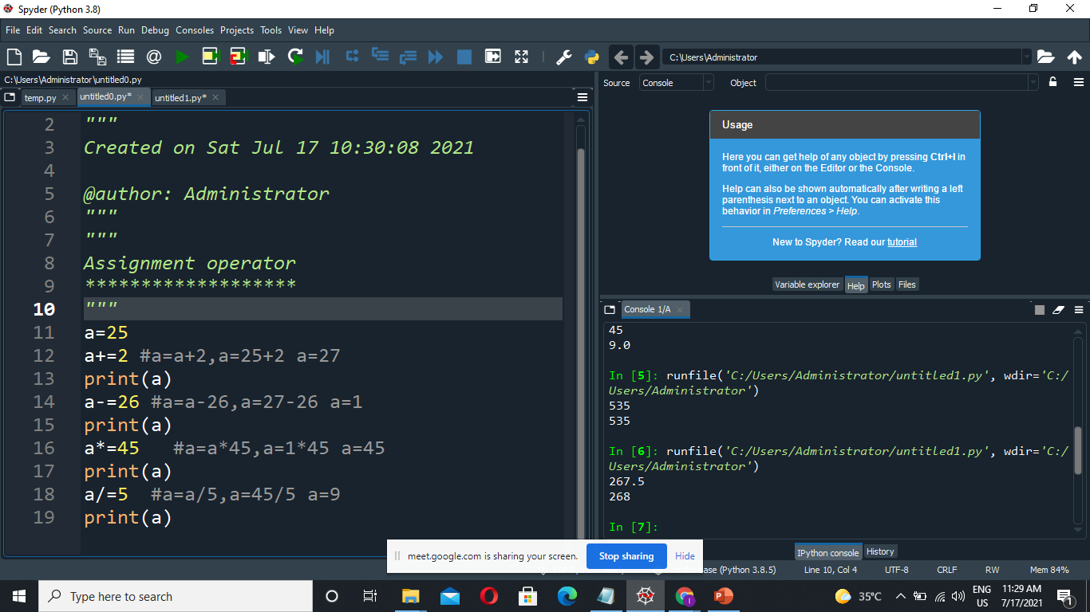
EXAMPLE

Slide 15
Comparison Operator or Relational Operator
OPERATORS >,<,>=,<=,==,!=
>Greater than
<Less than
>=Greater than or Equal to
<=Less than or Equal to
==Equal
!=Not Equal

Slide 16
Example Program
a=10
b=20
Print(a>b)
Print(a<b)
Print(a>=b)
Print(a<=b)
Print(a==b)
Print(a!=b)

Slide 17
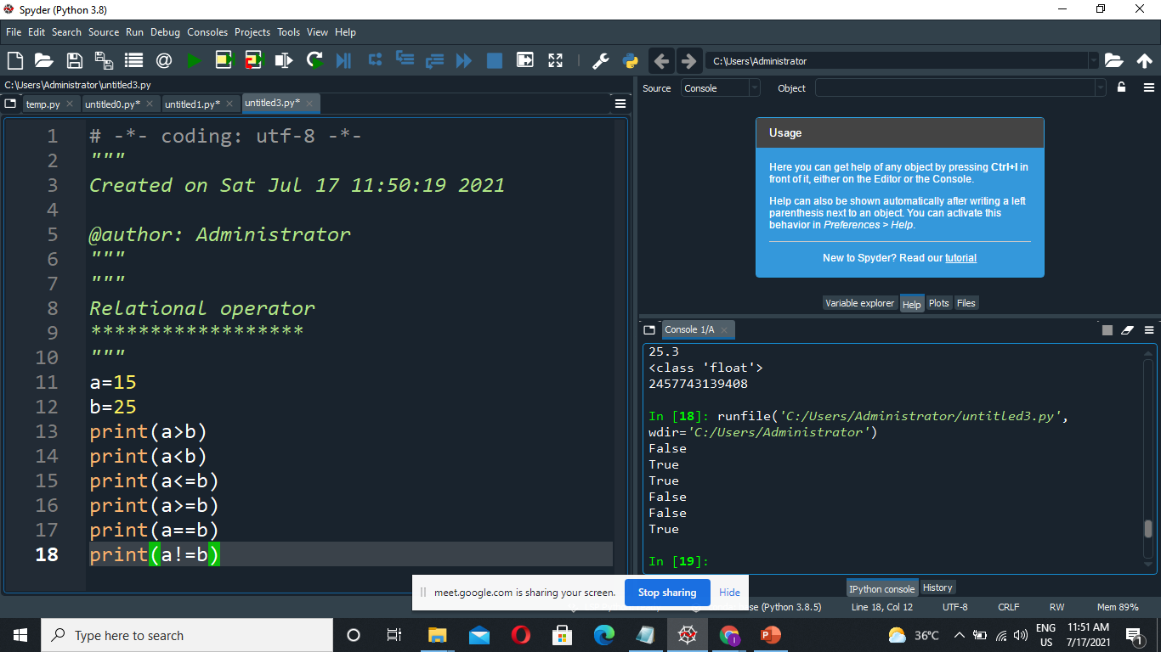
EXAMPLE

Slide 18
Logical Operator
OPERATORS and, or, not
and (&&)
or (||)
not (!)
1=true
0=False

Slide 19
Logical Operator Formula
and
1 and 1 =1
1 and 0=0
0 and 1=0
0 and0 =0
Not
1=0
0=1
or
1 or 1 =1
1 or 0=1
0 or 1=1
0 or 0=0

Slide 20
Example Program
a=10
print(a>=10 and a<=20) 1 and 1=1
a=25
print(a>=10 or a<=15) 1 or 0=1
a=10
Print(not(a>=10 and a<=20)) 1 and a=0

Slide 21
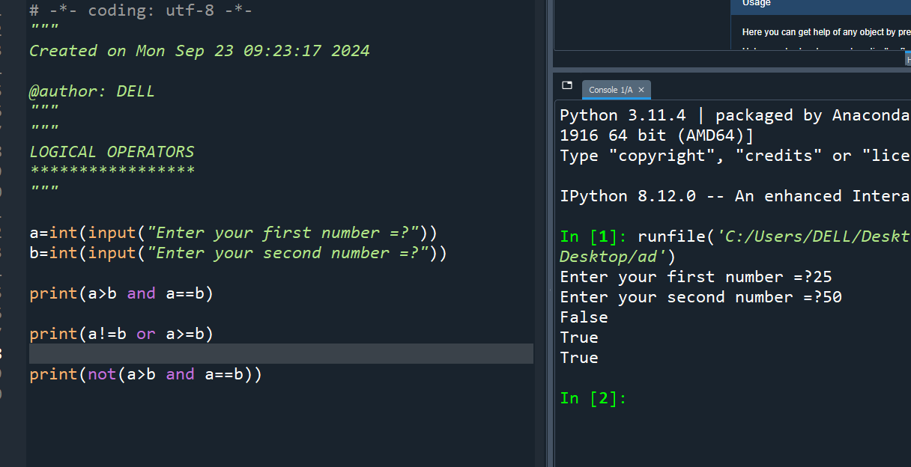
EXAMPLE

Slide 22
Bitwise Operator
OPERATORS &, |, ^, ~
AND (&)
OR(|)
XOR(^)
NOT(~)
AND 1 1=1
10=0
01=0
00=0
OR 11=1
01=1
10=1
00=0
XOR 11=0
10=1
01=1
00=0

Slide 23
Example binary base value 2
a=10=>2
b=11=>2
Print(a&b)1010&1011=1010=10
Print(a|b)1010|1011=1011=11
Print(a^b)1010^1011=0001=1
Print(~a)
10
2
2
5
0
(a|b)
10 =1010
11= 1011
1011
2
2
1
10=1010
1
0
2
11
2
5
1
2
2
1
11=1011
~1010
1
0
(a^b)
10 =1010
11= 1011
0001

Slide 24
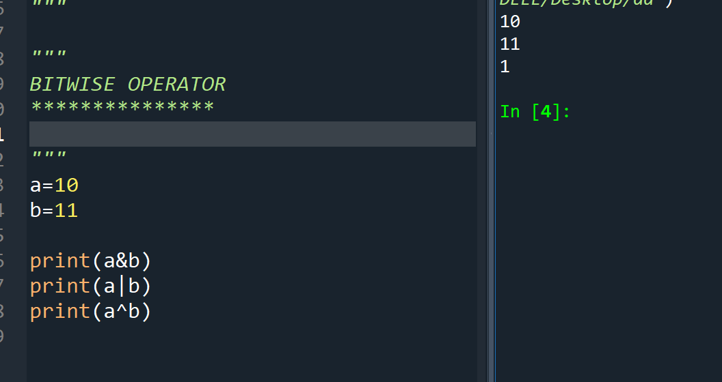
EXAMPLE

Slide 25
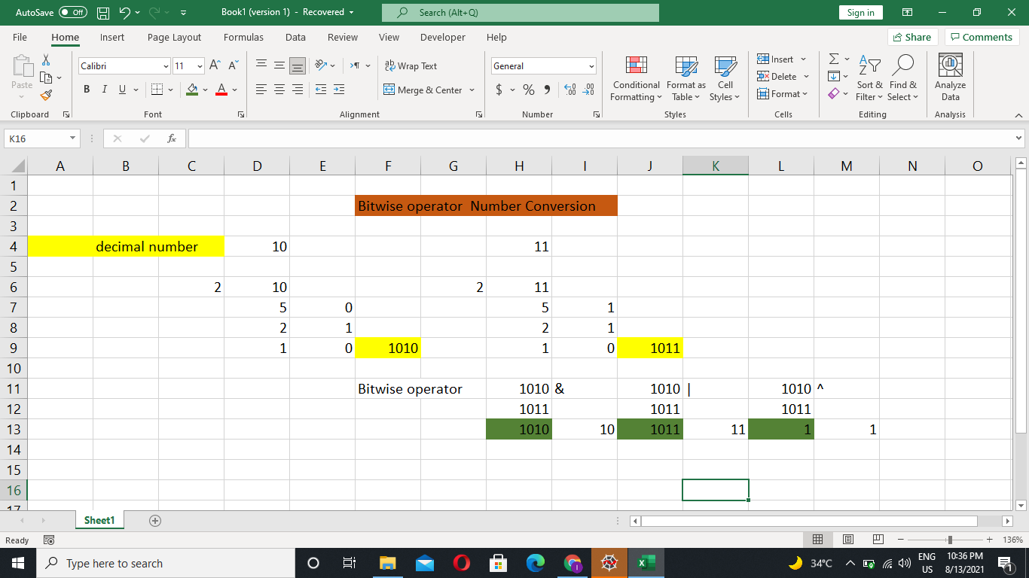
BITWISE Coding Manual Explanation

Slide 26
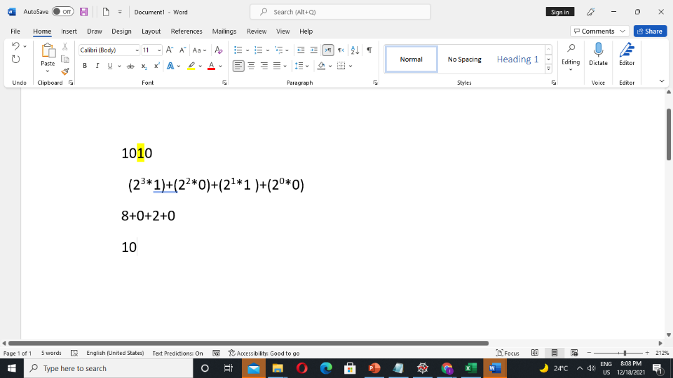
Binary to Decimal
Method 1
Method 2
1 0 1 0
128 64 32 16 8 4 2 1
=(1*8)+(2*1)
=10

Slide 27
BITWISE NOT OPERATOR
In Python, bitwise operators are used to perform bitwise calculations on integers. ... Bitwise not operator: Returns one's compliement of the number. Example: a = 10 = 1010 (Binary) ~a = ~1010 = -(1010 + 1) = -(1011) = -11
a=10 1010
~a=-(1010+1) 10+1
=-10+1
=-11
a=11 1011
~a=-( 1011+1)
=-12

Slide 28
Thank You

